Slide 1
Physically Unclonable Function on FPGA
Group Members:-
Shriniket behera (23110306)
Siddhesh Umarjee(23110347)
Shounak Ranade(23110304)
Parth Dembla(23110234)

Slide 2
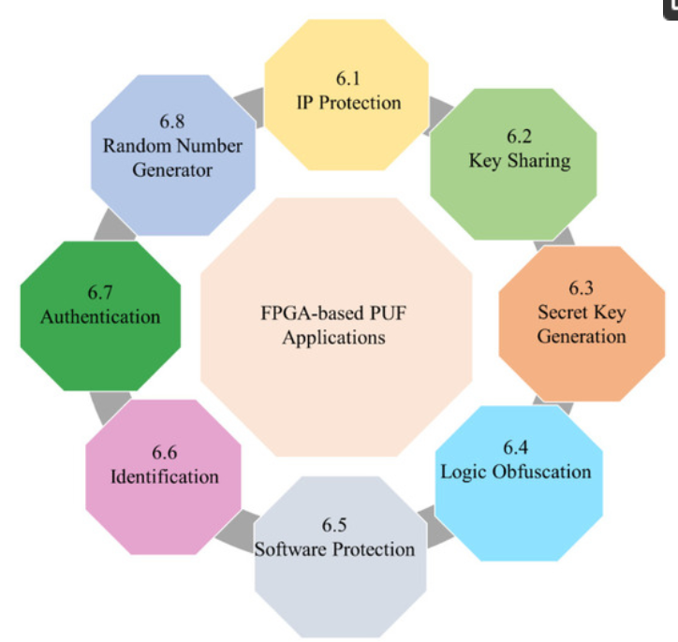
Problem statement of this project was to implement a physically unclonable function on FPGA .
Physically Unclonable Functions (PUFs) have been proposed as central building blocks in cryptographic protocols and security architecture ; PUF can be used as random number generator ; secret key generation; IP protection
FPGA technology expands PUF integration across diverse hardware systems. FPGA-based PUF designs provides methods to assist in bridging the gap between the PUF usages for security purposes in many applications and FPGA growing market for design implementations

Slide 3
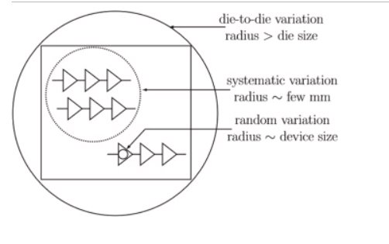
PUFs are hardware security structures that leverage the random and unique physical variations inherent in semiconductor devices during the manufacturing process.
The manufacturing process introduces inherent variations in the physical properties of transistors, capacitors, resistors, and other components on the chip.
As a result, even chips produced on the same production line within the same batch will have minute differences in their electrical characteristics.
These variations are uncontrollable and arise due to imperfections and process fluctuations, making them difficult to replicate or clone intentionally.
These small but significant variations can be exploited to create a unique response or identifier for each individual chip. When a challenge is presented to the PUF, it generates a response based on its inherent variations.
So our main aim of this project was to implement PUF circuits for random number generations on FPGA boards and test weather numbers generated are random or not by testing them on different FPGA’s​

Slide 4
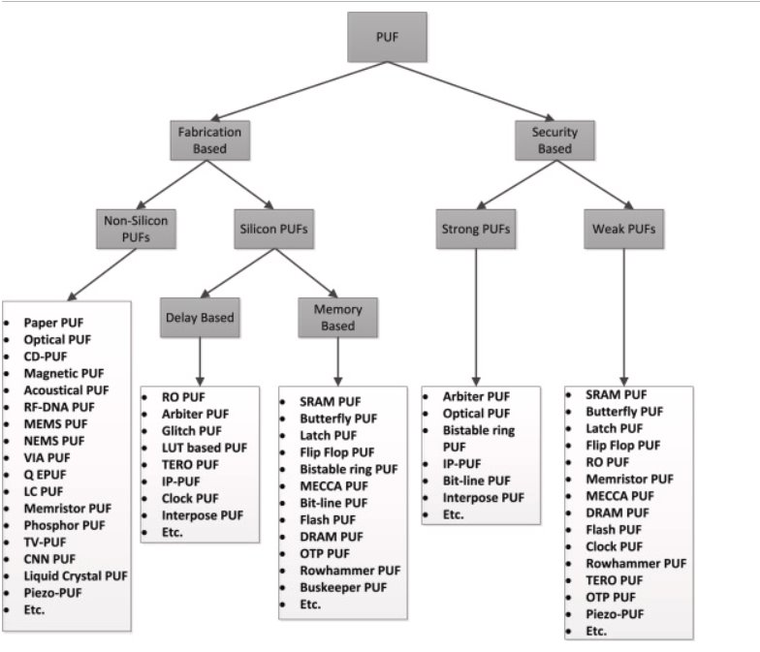
PUF’s can be classified based on fabrication and security ​
​
​

Slide 5
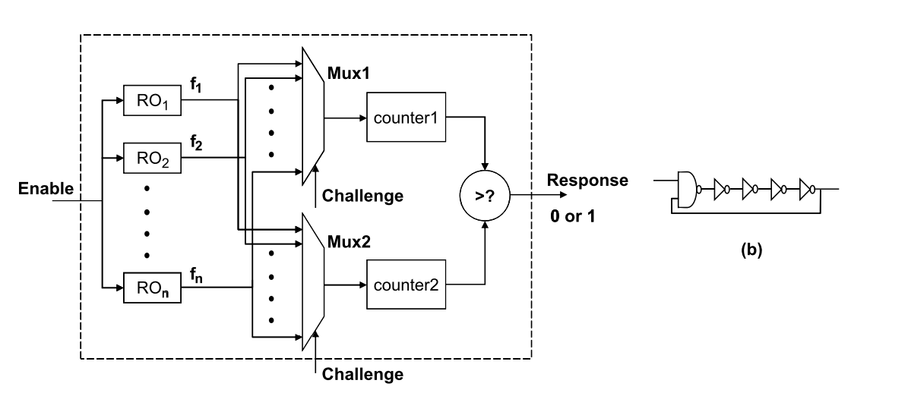
The PUF chosen by us to implement on FPGA board is a delay based PUF called Ring Oscillator PUF (RO PUF)
Due to it’s sensitivity process variations , RO has been used widely in modeling process variations with good results
implementing several identical ROs on FPGAs for a PUF is simplified by using the hard-macro design technique.
Ring Oscillator PUF Scheme

Slide 6
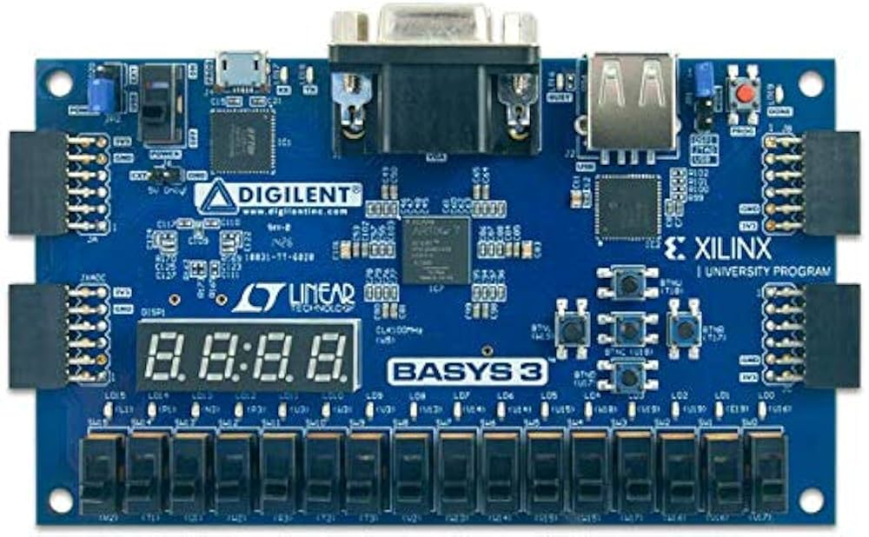

For implementation of RO PUF on FPGA board we used Digilent Basys3 Xilinx Artix-7 FPGA Board.
The software used for writing Verilog and synthesizing the code was AMD Vivado™ Design Suite.
Verilog code for implementation of RO PUF
Synthesized on FPGA board
Ro’s synthesized have random propagation delays
To see weather numbers are truly random ; CRP’s were generated on 5 different FPGA boards
For a given challenge bit , response bit generated forming CRP’s
(challenge response pair)

Slide 7
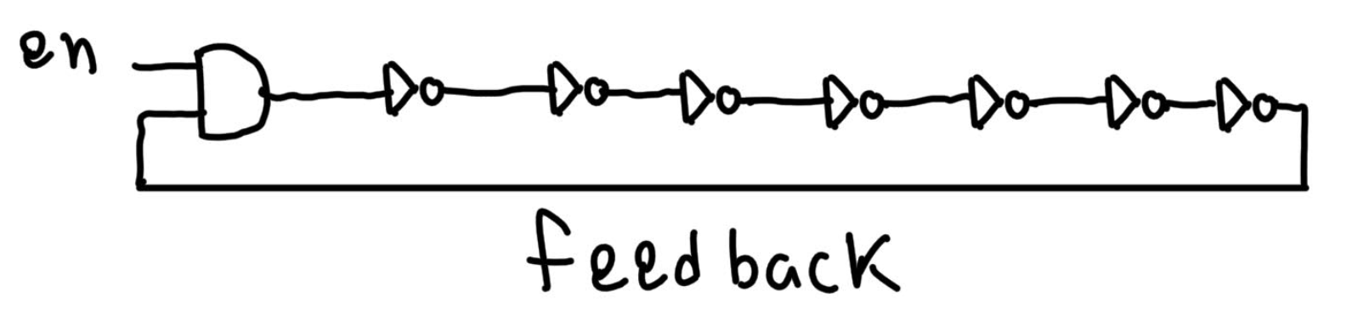
Components Required for Implementation :-
1) Ring Oscillator with an AND gate and 7 inverters in cascade is used enable signal and feedback are given as inputs to the ring oscillators
2) Multiplexers depending on the number of ring oscillators the size of MUX is decided; we are using 8 ring oscillators ; so two 4X1 MUX are required
3)Linear Feedback Shift Register (LFSR) to automatically change challenge(4 bit input)
4) Counter
5) Comparator

Slide 8
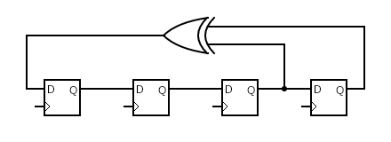
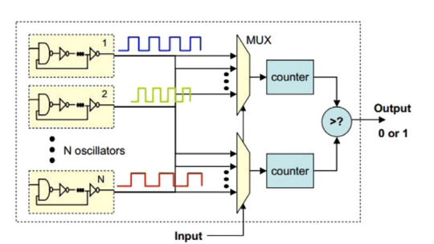
Changes 4 bit challenge input automatically
4X1 MUX with 2 out of 4 bits of challenge as selection control(other 2 bits goes to second MUX)
4 Bit LFSR Circuit
Comparator module ; produces a 1 if count corresponding to first MUX is more than count corresponding to second MUX

Slide 9
N identically arranged delay loops—also known as ring oscillators (ROs)—two multiplexers, two counters, and an arbiter make up a standard RO PUF.
Theoretically, each RO oscillates at the same frequency, but in practice, each RO oscillates at a slightly variable frequency due to manufacturing differences and environmental factors.(when RO’s will be synthesized on FPGA , they will have different frequencies)
A pair of these N ROs must be chosen in order to produce a one-bit response.
The input (challenge) applied to both MUX and a comparison of the frequency of the chosen RO pair serve to determine this choice.

Slide 10


Implementation
Youtube Link for Code Explaination and Implementation
Github Repository For Codes

Slide 11
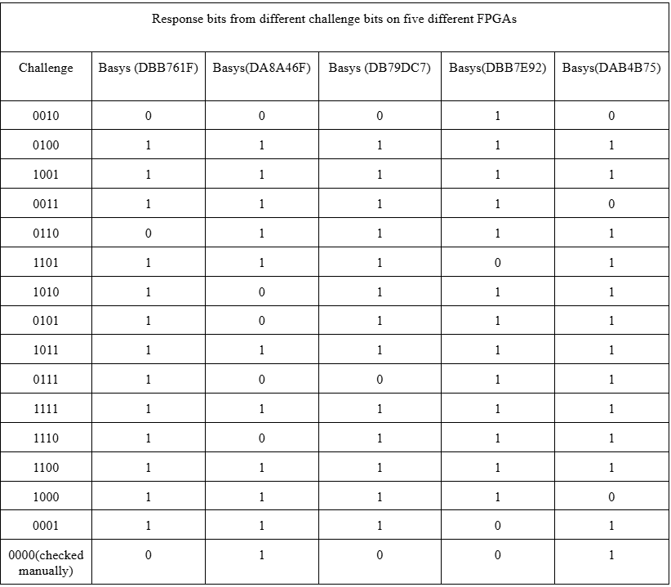
Results:-

Slide 12
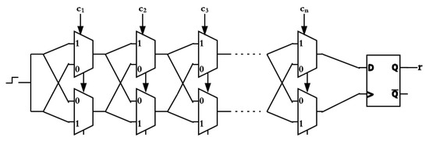
Another type of delay based PUF attempted by us to implement on FPGA was Arbiter PUF
Challenge Faced to implement this :-
Symmetric Routing
FPGA place-and-route tools optimize the paths too uniformly.
Result: The delay difference is negligible or always leans toward one path → constant output.

Slide 13
References :-
Improved Ring Oscillator PUF: An FPGA-Friendly Secure Primitive A. Maiti and P. Schaumont, "Improved Ring Oscillator PUF: An FPGA-Friendly Secure Primitive," Journal of Cryptology, vol. 24, no. 2, pp. 375–397, Apr. 2011, doi: 10.1007/s00145-010-9088-4.
Improved Ring Oscillator PUF - An FPGA-friendly Secure Primitive (from ScienceDirect link) A. Maiti and P. Schaumont, “Improved Ring Oscillator PUF - An FPGA-friendly Secure Primitive,” ScienceDirect, Microprocessors and Microsystems, vol. 76, p. 103108, May 2020, doi: 10.1016/j.micpro.2020.103108.
FPGA-Based PUF Designs: A Comprehensive Review and Comparative Analysis K. Lata and L. R. Cenkeramaddi, "FPGA-Based PUF Designs: A Comprehensive Review and Comparative Analysis," Cryptography, vol. 7, no. 4, p. 55, Nov. 2023, doi: 10.3390/cryptography7040055.

Slide 14
THANK YOU

